Slide 1
Nim Game using RL
Ali Al Housseini – S287634

Slide 2
01
02
03
Introduction
The environment
Implementation
04
05
06
Training & Testing
Results & Conclusion
Next Steps

Slide 3
01
INTRODUCTION
Definition of RL and Nim Game

Slide 4

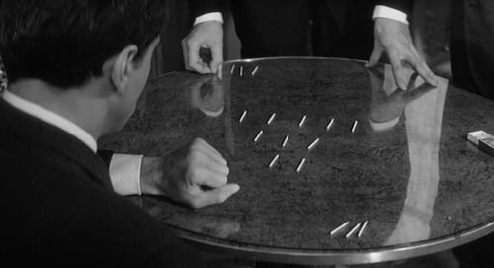
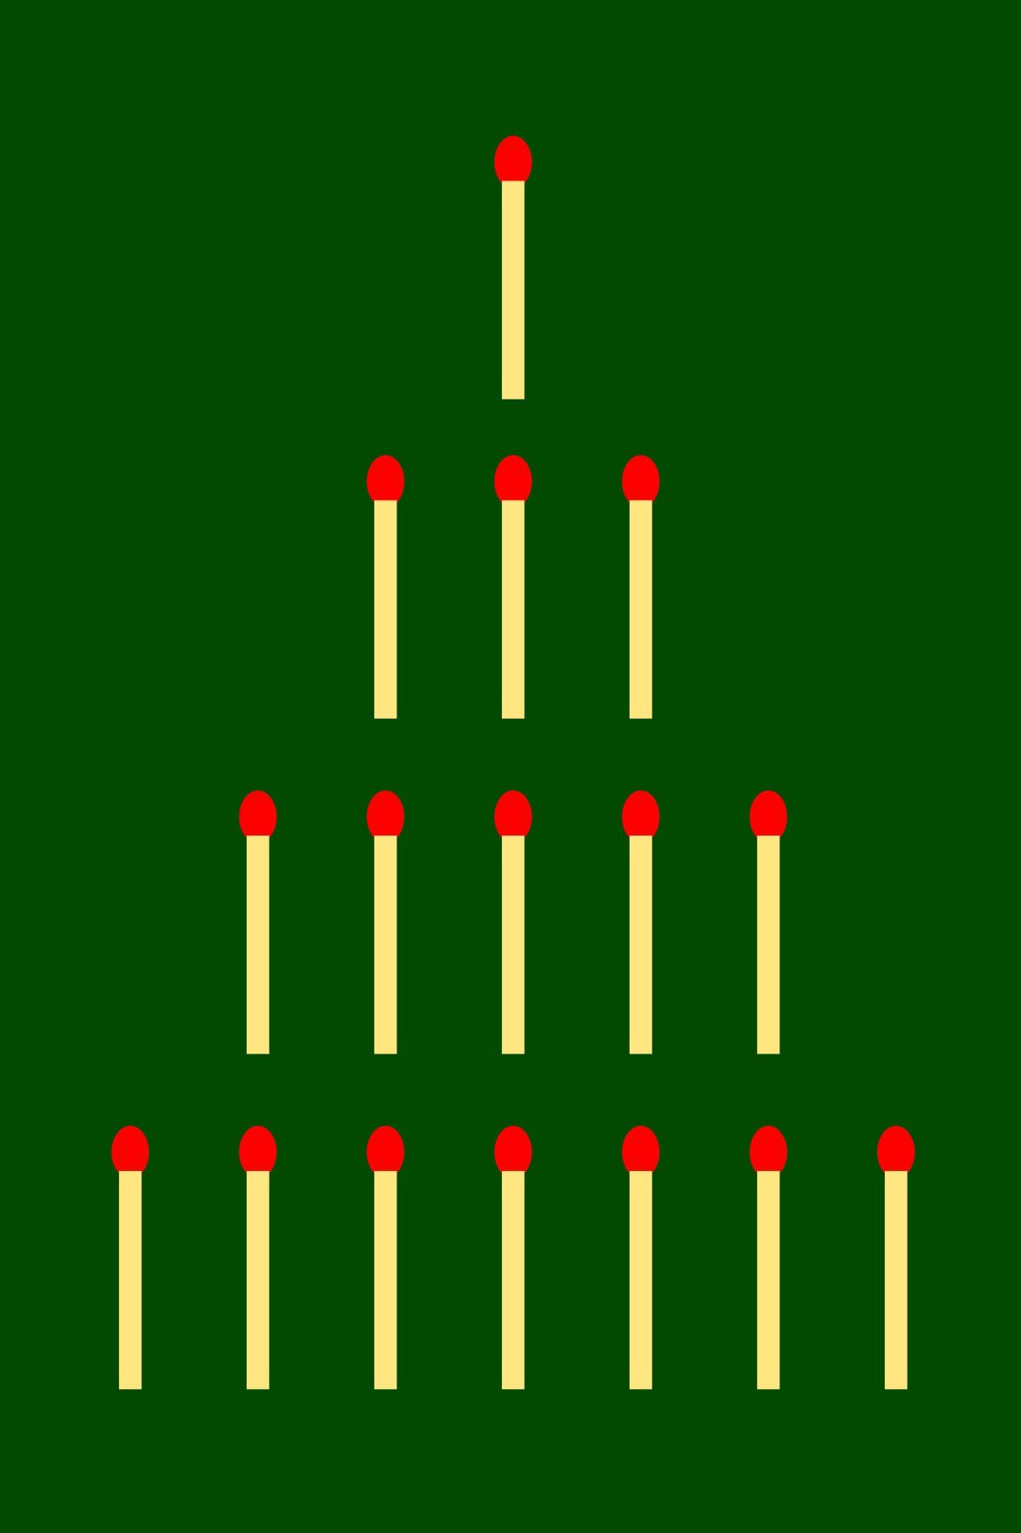
The player who cannot move is considered to lose the game Taking last Object == WIN!

Slide 5
What is Reinforcement Learning
RL is an area of machine learning where an agent learns to make decisions by performing actions in an enviroment
It is widely used in various applications such as autonomous vehicles and game theory

Slide 6
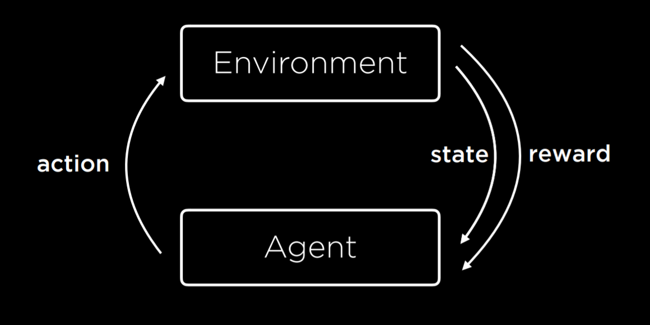
WHOA
This can be the part of the presentation where you introduce yourself, write your email…
Image taken from CS’50 Harvard Course

Slide 7
Environment
Environment Configuration and parameters setup

Slide 8
Our Environment - 1
State/Observation Space
Action Space
Reward
1D array where each elements refers to a pile
2D-array of all possible (and non possible actions)
-10 if the agent loses
+15 if the agent wins
+1 for a valid action
-5 for an invalid action

Slide 9
Our Environment - 2
Box Space
MultiDiscrete
Observation space (n=5)
Action space
1
3
5
7
9
[0,1] | [1,1]
[1,2] | [1,3]
[2,1] | [2,2]
[2,3] | [2,4]
[2,5] | etc…
For more info visit: https://www.gymlibrary.dev/api/spaces/

Slide 10
01
Implementation
Most important parts of the code to be mentioned

Slide 11
PseudoCode
NimAI Class
step(action)
Attributes:
- No. of Piles
- Initial state
- Initial action space
- Current Player (0/1)
Methods:
- switch_player()
- check_end_game()
- step(action)
- reset()
- render()
- Take an action
- Set reward=0
Check validity of the action
Action = [pile, obj] is valid.
Remove from pile obj elements
check_end_game()
Action not valid!
switch_player()
r = -5
Player 1 plays a valid move
PLAYER 0 WINS!
r = +15
Player 0 lose
r = -10
check_end_game()
Game not finished yet (repeat)
r = +1

Slide 12
PseudoCode
NimAI Class
step(action)
Attributes:
- No. of Piles
- Initial state
- Initial action space
- Current Player (0/1)
Methods:
- switch_player()
- check_end_game()
- step(action)
- reset()
- render()
- Take an action
- Set reward=0
Check validity of the action
Action = [pile, obj] is valid.
Remove from pile obj elements
check_end_game()
Action not valid!
switch_player()
r = -5
Player 1 plays a valid move
PLAYER 0 WINS!
r = +15
Player 0 lose
r = -10
check_end_game()
Game not finished yet (repeat)
r = +1

Slide 13
Training & Testing
Main Keypoints (Training the agent)

Slide 14
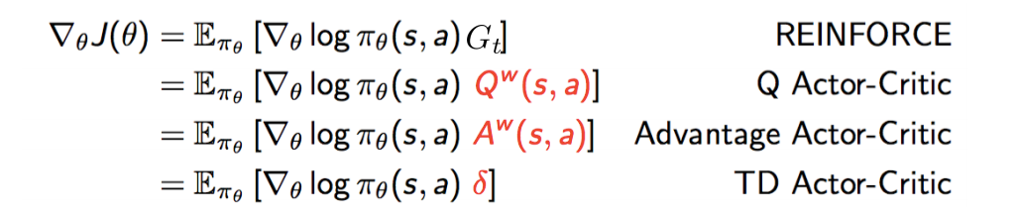
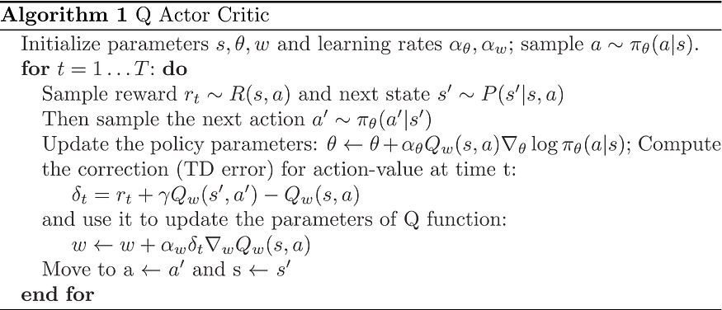
Training - 1
The training has been done using Advantage Actor Critic (A2C)
240,000 timestep per epoch
A2C stands for Advantage Actor-Critic, which basically describes the algorithm at a high level. There's an actor, which is a model (e.g., neural net) which takes as input the state and outputs the action, and there's a critic, which is another model which takes as input the state and outputs the value of that state (i.e., the expected future cumulative discounted reward your agent will receive starting at that state). The advantage is the difference between the value and some baseline expectation for the reward, such that the advantage represents how well your agent is acting relative to the average reward it'd normally get.

Slide 15
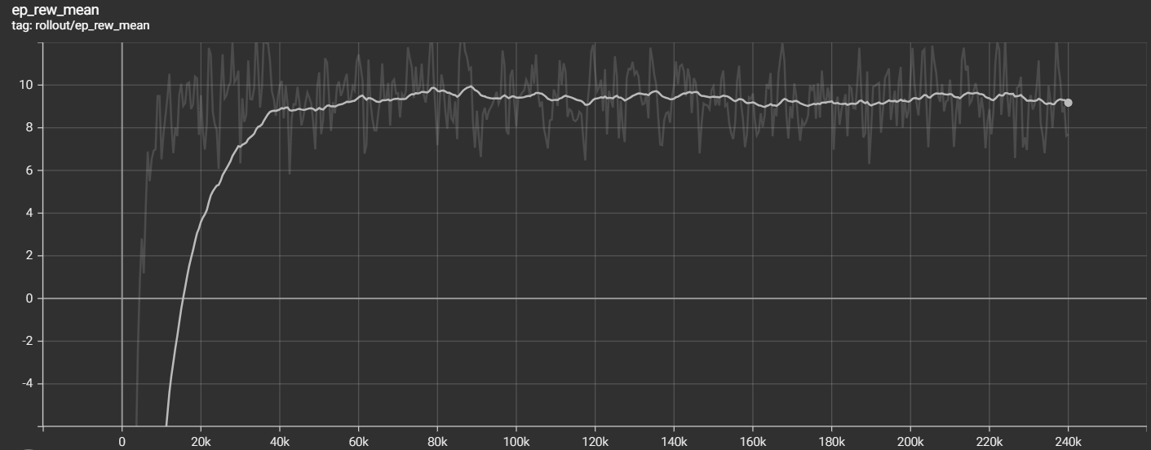
Training - 2
The training has been done using Advantage Actor Critic (A2C)
240,000 timestep per epoch
* Screenshot from tensorboard

Slide 16
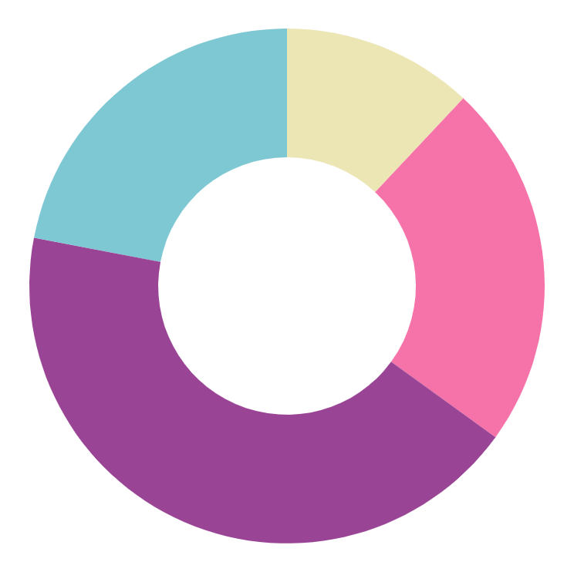
Testing
3 piles
4 piles
98% Win!
84% Win!
5 piles
7 piles
74% Win!
57% Win!
The agent has been tested on around 500 episodes. (500 games for each case)

Slide 17
01
Results and Conclusion
How to INTERPRET these results?

Slide 18

Quite promising RESULTS
I saved for all winning games the (state, action) pairs for study in an external notebook.
Let’s try to figure out how our agent won!?

Slide 19
68%
of wins were using NIMSUM Strategy!

Slide 20
Imagine we didn’t have any previous knowledge about this strategy ☺

Slide 21
Discover ?
Learn from AI ?
or maybe understand how we learn

Slide 22
Next Steps
What to do next after this work?

Slide 23
What’s next
Improve results by training more.
Explore new techniques and try to find the most suitable for (each) use case
Work more to prove that this RL agent learned NIMSUM by successive trials

Slide 24
THANK YOU FOR YOUR ATTENTION

Slide 25





Ali Al Housseini – S287634
References
/alialhousseini
http://rail.eecs.berkeley.edu/deeprlcourse-fa17/f17docs/lecture_4_policy_gradient.pdf
https://lilianweng.github.io/posts/2018-04-08-policy-gradient/
https://medium.com/@thechrisyoon/deriving-policy-gradients-and-implementing-reinforce-f887949bd63
/alialhousseini
www.alialhousseini.com

